Slide 1
Memory Organization
The memory unit that communicates directly with the called CPU is called the main memory.
Devices that provide backup storage are auxiliary memory. The most common auxiliary memory devices used in computer systems are magnetic disks and tapes. They are used for storing system programs, large data files, and other backup information.
Only programs and data currently needed by the processor reside in main memory. All other information Is stored in auxiliary memory and transferred to main memory when needed.

Slide 2
Memory Hierarchy in a Computer System
The memory hierarchy system consists of all storage devices employed in a computer system from the slow but high-capacity auxiliary memory to a relatively faster main memory, to an even smaller and faster cache memory accessible to the high-speed processing logic.
Magnetic tapes used to store removable files. Next are the magnetic disks used as backup storage.
The main memory occupies a central position by being able to communicate directly with the CPU and with auxiliary memory devices.
When programs not residing in main memory are needed by the CPU, they are brought in from auxiliary memory. Programs not currently needed in main memory are transferred into auxiliary memory to provide space for currently used programs and data.
A special very-high·speed memory called a Cache is sometimes used to increase the speed of processing by making current programs and data available to the CPU at a rapid rate. The cache memory is employed in computer systems to compensate for the speed differential between main memory access time and processor logic. CPU logic is usually faster than main memory access time, with the result that processing speed is limited primarily by the speed of main memory. A technique used to compensate for the mismatch in operating speeds is to employ an extremely fast, small cache between the CPU and main memory whose access time is close to processor logic dock cycle time.

Slide 3
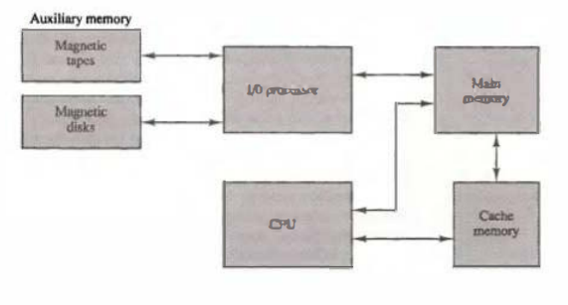
Memory Hierarchy in a Computer System

Slide 4
Main Memory(RAM & ROM)
The main memory is the central storage unit in a computer system. It is a relatively large and fast memory used to store programs and data during the computer operation. The principal technology used for the main memory is based on semiconductor integrated circuits. Integrated circuit RAM chips are available in two possible operating modes, static and dynamic.
The static RAM consists essentially of internal flip-flops that store the binary information. The stored information remains valid as long as power is applied to the unit. The dynamic RAM stores the binary information in the form of electric charges that are applied to capacitors. The capacitors are provided inside the chip by MOS transistors. The stored charge on the capacitors tend to discharge with time and the capacitors must be periodically recharged by refreshing the dynamic memory. Refreshing is done by cycling through the words every few milliseconds to restore the decaying charge.

Slide 5
Main Memory(RAM & ROM)
Most of the main memory in a general-purpose computer is made up of RAM integrated circuit chips, but a portion of the memory may be constructed with ROM chips.
Originally, RAM was used to refer to a random-access memory, but now it is used to designate a read/write memory to distinguish it from a read-only memory, although ROM is also random access.
RAM is used for storing the bulk of the programs and data that are subject to change.
ROM is used for storing programs that are permanently resident in the computer and for tables of constants that do not change in value once the production of the computer is completed.

Slide 6
Bootstrap Loader: Among other things, the ROM portion of main memory is needed for storing an initial program called a bootstrap loader. The bootstrap loader is a program whose function is to start the computer software operating when power is turned on. Since RAM is volatile, its contents are destroyed when power is turned off. The contents of ROM remain unchanged after power is turned off and on again.
Computer Startup: The startup of a computer consists of turning the power on and starting the execution of an initial program. Thus when power is turned on, the hardware of the computer sets the program counter to the first address of the bootstrap loader. The bootstrap program loads a portion of the operating system from disk to main memory and control is then transferred to the operating system, which prepares the computer for general use.

Slide 7
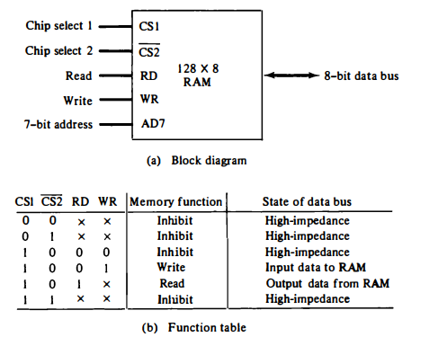
RAM Organization

Slide 8
RAM Organization
A RAM chip is better suited for communication with the CPU if it has one or more control inputs that select the chip only when needed. Another common feature is a bidirectional data bus that allows the transfer of data either from memory to CPU during a read operation, or from CPU to memory during a write operation.
The capacity of the memory is 128 words of eight bits (one byte) per word. This requires a 7-bit address and an 8-bit bidirectional data bus. The read and write inputs specifies the memory operation and the two chips select (CS) control inputs are for enabling the chip only when it is selected by the microprocessor.
The unit is in operation only when CS1 = 1 and (CS2)’ = 0. The bar on tor of the second select variable indicates that this input is enabled when it is equal to 0. If the chip select inputs are not enabled, or if they are enabled but the read or write inputs are not enabled, the memory is inhibited and its data bus is in a high-impedance state.
When CS1 = 1 and (CS2)’ = 0, the memory can be placed in a write or read mode. When the WR input is enabled, the memory stores a byte from the data bus into a location specified by the address input lines. When the RD input is enabled, the content of the selected byte is placed into the data bus.

Slide 9
Auxiliary Memory (Magnetic Disc & Tapes)
The most common auxiliary memory devices used in computer systems are magnetic disks and tapes.
Magnetic Disc: A magnetic disk is a circular plate constructed of metal or plastic coated with magnetized material. Often both sides of the disk are used and several disks may be stacked on one spindle with read/write heads available on each surface. All disks rotate together at high speed and are not stopped or started for access purposes. Bits are stored in the magnetized surface in spots along concentric circles called tracks. The tracks are commonly divided into sections called sectors. In most systems, the minimum quantity of information which can be transferred is a sector.
Magnetic Tape: A magnetic tape transport consists of the electrical, mechanical, and electronic components to provide the parts and control mechanism for a magnetic-tape unit. The tape itself is a strip of plastic coated with a magnetic recording medium. Bits are recorded as magnetic spots on the tape along several tracks. Usually, seven or nine bits are recorded simultaneously to form a character together with a parity bit. Read/write heads are mounted one in each track so that data can be recorded and read as a sequence of characters.

